Slide 1

Ruby on Rails

Slide 2
About today…
Ruby on Rails
Deployment on Heroku

Slide 3

D E P L O Y M E N T

Slide 4
Features of Heroku
Platform as a Service (PaaS)
Description
Fully managed PaaS, allowing developers to deploy, manage, and scale applications
Benefit
Simplifies deployment processes, enabling developers to focus on writing code
Support for Multiple Languages
Description
Supports several programming languages, including Ruby, Python, Node.js, PHP etc
Benefit
Flexibility to use Heroku for a variety of projects beyond just Rails applications
Managed Databases
Description
Provides managed PostgreSQL databases (Heroku Postgres), Redis, and more
Benefit
Simplifies database management, backup, and scaling

Slide 5
Why Heroku
Optimized for Ruby and Rails
Description
Initially designed to support Ruby/Rails apps, providing an optimized environment
Benefit
Seamless integration and support for Rails features and conventions
Easy Setup and Deployment
Description
Simplifies the setup and deployment process for Rails applications
Benefit
Quick deployment with minimal configuration, making it ideal for rapid development
Built-in PostgreSQL Support
Description
PostgreSQL is the default database for Rails applications on Heroku
Benefit
Native support and easy provisioning of a powerful relational database

Slide 6
LOCAL
STRUCTURE

Slide 7

Introduction to Local Setup
Prepare your local environment for deploying a Rails application to Heroku
Tools Needed
Ruby
Rails
PostgreSQL
Git
Heroku CLI

Slide 8
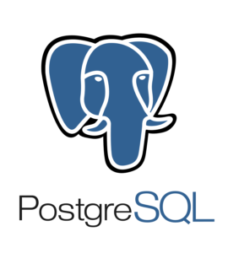


Add the pg Gem
Edit gem file
Install the Gem

Slide 9
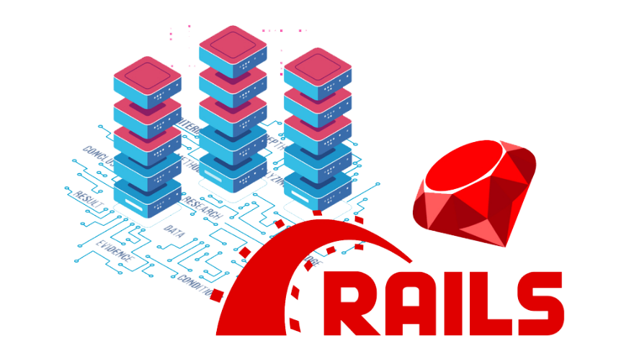

Create a Rails app
Specify the Ruby version
Edit Gemfile

Slide 10
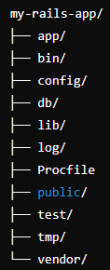
Procfile Intro
Definition
Text file in the root directory of application that explicitly
declares what command should be executed to start your app
Purpose
It helps Heroku understand how to run your application
Where to Create?
root directory of your Rails application

Slide 11



How to create Procfile
Navigate to the Root Directory
Create the Procfile
Using a text editor, create a new file named Procfile
Contents
Save the File
Save the file in the root directory of your Rails application

Slide 12

Purpose of the Procfile Entry
web
Specifies the type of process. In this case, it's a web server
bundle exec rails server -p $PORT
The command to run the Rails server on the port provided by Heroku

Slide 13



Store The App in Git
Initialize Git Repository
Add and Commit Files

Slide 14
HEROKU
SETTINGS

Slide 15


Create a Heroku App
On Local Computer
On Heroku Dashboard
Go to dashboard.heroku.com
Click on "New" and select "Create new app"
Enter a unique app name and choose a region
Click "Create app"

Slide 16

Provision a Database
On Heroku Dashboard
Go to your app
Click on the "Resources" tab
In the "Add-ons" section, search for "Heroku Postgres"
Select the free plan and click "Provision"

Slide 17



Deploy the app to Heroku
Migrate The Database

Slide 18


Slide 19

What is the purpose of a Procfile in a Rails application deployed on Heroku?
The Procfile specifies the command to start the application on Heroku
Where should you create the Procfile in your Rails application directory structure?
In the root directory of the application
What command is typically specified in a Procfile for a Rails application's web process?
web: bundle exec rails server -p $PORT
What is the correct sequence of steps to create a Procfile in your Rails application?
Navigate to the root directory, open a text editor, create a file named Procfile, add a command, and save

